Slide 1
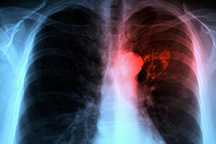
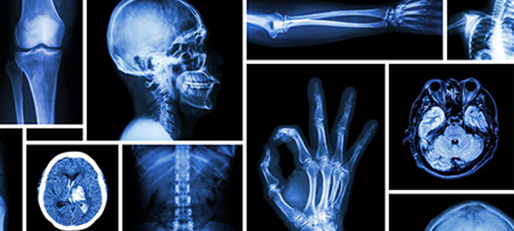
Come see current Resident and Fellow research
Present your findings!
Medical Imaging Research Day
May 21
Prizes awarded
to top display
Tuesday , May 21
11:30 AM- 1:00 PM
HSIB
Lunch
Will be Served!
All electronic presentations and
posters from July 1, 2018-
June 30, 2019 are welcome.
Sign up with Melissa in Room 1343 or via Emailmruiz@radiology.arizona.edu
by April 23rd.

